Slide 1


Android: Anatomy of Android apps
LEIM – DAM

Slide 2

Android apps & Linux aspects
Apps can be written using Kotlin, Java, and C++ language
Code, data and resource files are packed into an APK file
Android apps are installed and run on a multi-user linux system
Each app is assigned to a new linux user
Apps only access files that belongs to their own user
An app in execution is a Linux process running an ART VM
Apps are isolated from other apps
When an app is not running and one app component is needed the system creates a process for it
When the app is not needed or when the system needs memory for other apps the process is terminated
Apps need explicit user permission to access device resources like: camera, Bluetooth, device’s location

Slide 3
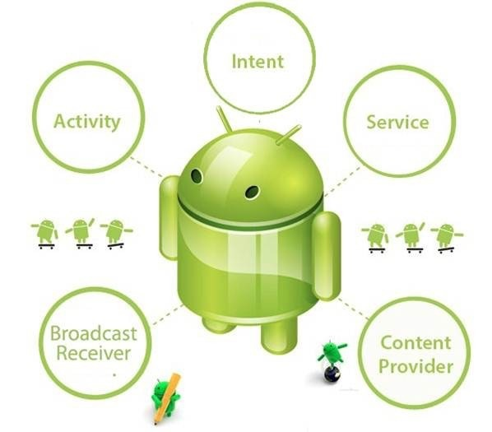
Android app philosophy
An Android app should be a modular application composed by several components
These components provide entry, or interaction, points for the user, the system or other apps to interact with the app
User interaction – called Activities
Background execution – called Services
System notification – called Broadcast Receivers
Storage – called Content Providers
These components are activated and destroyed by the system when needed
If the system needs memory the app process and all components may be destroyed
To call/use one component we must use Intents
https://developer.android.com/guide/components/fundamentals?hl=en

Slide 4
Android app jumping
A social network photo sharing scenario:
In a social network app we want to take and share a photo – social app triggers camera app
Social network app suspended
Camera app may triggers other apps, like a File chooser app, which may call other app
File Chooser app / camera app suspended
The user return to social network app and shares the photo
Android minimizes the suspended apps, it may destroy them
When needed, they will be re-started
The modular architecture of Apps should enable this destroy/re-start life-cycle

Slide 5
App composition
Code
Use
Layouts
Other
Resources
An Android app should contain:
Code
The app code in several classes
Resources
layouts, images, menus, styles, colors, audio files
Being separate from code enable to provide sets of resources to be used depending on device (e.g. screen size) or user settings (e.g. language)
enable to adapt user interface without modifying code
AndroidManifest.xml File
Application configuration file where application characteristics are defined
Existing app components and their properties (start activity)
Interface between the application and the Android operating system
User required permissions, hardware and software required
Minimum API level required
At app installation, the system read this file to evaluates check application requirements

Slide 6
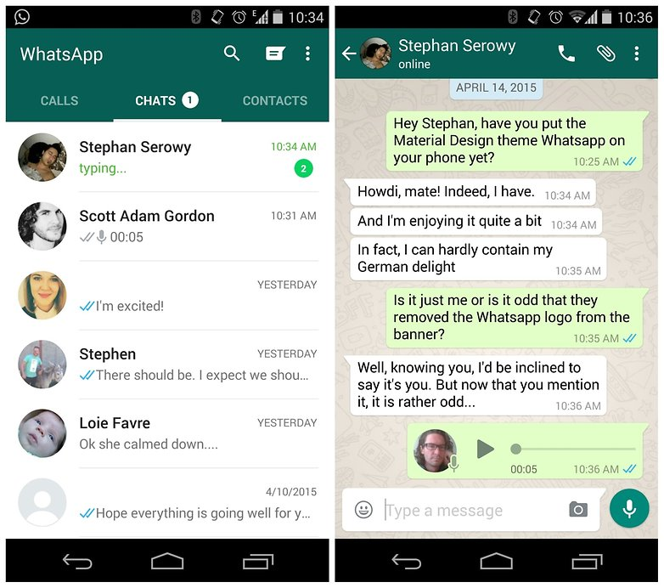
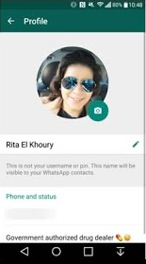
Activities
Introduction

Slide 7
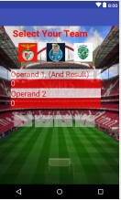
Activity
Provides an app entry point for user interaction
One email app might have:
one activity that shows a list of new emails,
another activity for reading an email, and
another activity to compose an email.
Should contains one screen for one user use case
One screen is supported by (one) Layout (ViewGroup) container
Layouts contain widgets (Views) to model the interface for user interaction
E.g.: TextViews, ImageViews, buttons, …
The start Activity is just one of them
It is specified in the Android Manifest file

Slide 8
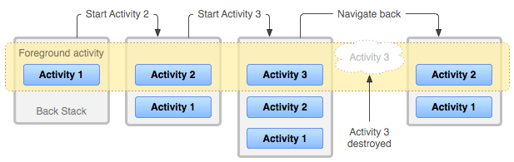
Activities: calling other activities
Activities may call another activities
in the same app or in other apps. Example: Email application
Activity 1 - shows the list of new emails
Activity 2 - reads an email
Activity 3 - writes and sends an email
Returns to Activity 2, then to Activity 1
The Activity return point are saved in a Stack called Back Stack
MainActivity
ChatActivity

Slide 9
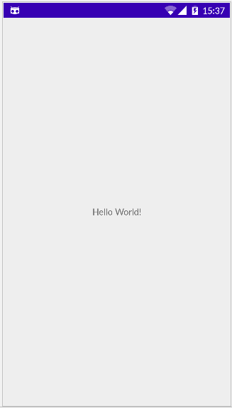
Activity: “MainActivity.java” file
An Activity is a subclass of Activity class
Subclass of AppCompatActivity to support action bar features
Activities must be declared in AndroidManifest.xml file
Must have an intent-filter to define how they are called
Action.MAIN: activity as main entry point and does not receive data
Category.LAUNCHER: activity should be displayed in the top-level launcher.
public class MainActivity extends Activity {
@Override protected void onCreate(Bundle savedInstanceState) { super.onCreate(savedInstanceState); // cal super onCreate
setContentView(R.layout.activity_main); // set activity layout
}
. . .
}

Slide 10

Layout: “activity_main.xml” file
Layout with a TextView with “Hello World!”
<? xml version="1.0" encoding="utf-8"?>
<androidx.constraintlayout.widget.ConstraintLayout
xmlns:android="http://schemas.android.com/apk/res/android" xmlns:app="http://schemas.android.com/apk/res-auto" xmlns:tools="http://schemas.android.com/tools" android:layout_width="match_parent" android:layout_height="match_parent" tools:context=".MainActivity"> <TextView android:layout_width="wrap_content" android:layout_height="wrap_content" android:text="Hello World!" app:layout_constraintBottom_toBottomOf="parent" app:layout_constraintLeft_toLeftOf="parent" app:layout_constraintRight_toRightOf="parent" app:layout_constraintTop_toTopOf="parent" /> </androidx.constraintlayout.widget.ConstraintLayout>

Slide 11
Activity: “AndroidManifest.xml” file
<? xml version="1.0" encoding="utf-8"?>
<manifest xmlns:android="http://schemas.android.com/apk/res/android" package="dam_a6000.languages">
<application
android:icon="@mipmap/ic_launcher"
android:label="@string/app_name“
android:theme="@style/AppTheme">
<activity android:name=".MainActivity"
<intent-filter>
<action android:name="android.intent.action.MAIN" />
<category android:name="android.intent.category.LAUNCHER" /
</intent-filter>
</activity>
</application>
</manifest>

Slide 12
AndroidManifest
Configuration
Package name, “target" version, version name, ...
Components
Activities, Intents, Services, ...,
Permissions
Internet access, access to contact list, ...
Libraries
Additional libraries that need to be linked
Hardware and Software Features
Video camera, bluetooth or multi-touch screens

Slide 13
AndroidManifest Elements
Element | Description
<activity> | To declare an activity
<application> | To declare the application. Contains all elements of the application
<meta-data> | It allows you to associate metadata to an application component
<permission> | Declare security permissions that can be used to limit access
<provider> | To declare a Content Provider
<supports-screens> | Let you specify the dimensions of the screens that the application supports
<uses-configuration> | Indicates the hardware and software required in the application
<uses-feature> | Declare a hardware or software feature used in the application
<uses-library> | Declare a shared library that must be "linked" to the application
<uses-permission> | Sets the permissions required for the application to run correctly
<uses-sdk> | It allows to define the minimum, maximum version and the version "target"
…

Slide 14

Services
Introduction

Slide 15
Services
Services are one type of app components that can performs (long) background operations/work for the app or other apps
Examples: play a background music; download some resource; perform some kind of computation
They do not provide an user interface
Services executes in background
Activities are "frozen" when the user moves to another Activity
Started services tell the system to keep them running until their work is completed
Activities can start services and let them run or bind to them in order to interact with them.

Slide 16
Services: Declaration and Creation
A service is a subclass of Service class
Needs to override the method Onbind
Returns the communication channel to the service (Object IBinder)
Services must be declared in AndroidManifest.xml file
Apps may use local or remote (from another apps) services
public class MyService extends Service {
@Override
public IBinder onBind(Intent intent) {
. . .
return . . .;
}
}
<application> ...
<service
android:name=".MyService" android:enabled="true"
android:exported="false" >
</service>
</application>
In android:name insert the name of the Service Class.
Android Studio gives help, just write <service

Slide 17
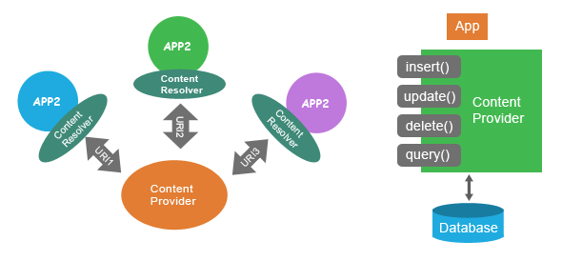
Content providers
Introduction

Slide 18
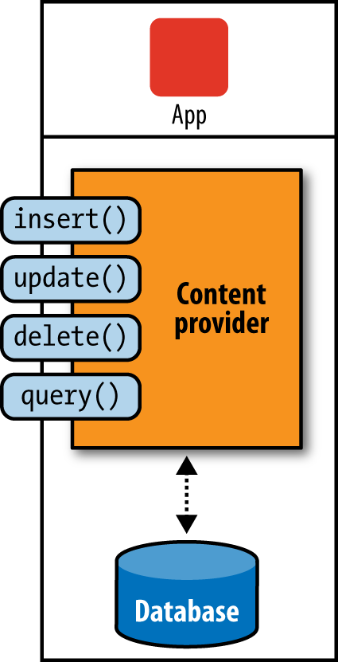
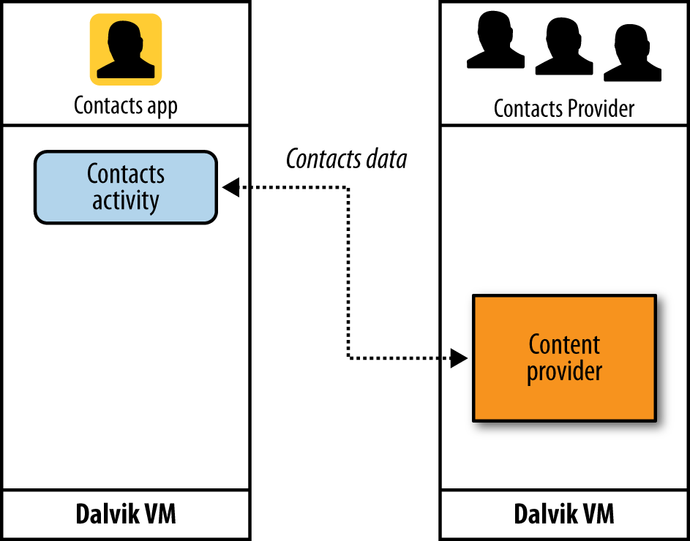
Content Providers
Used to save and access data within an application or to share data with other applications
Through the content provider, other apps can query or modify the data if the content provider allows it
Data can be in the file system, in a SQLite database, on the Web, or in any other location that the application can access
SQLite databases are databases in Android

Slide 19
Content Providers: Creation
A ContentProvider is a subclass of ContentProvider class
All methods, except onCreate(), may be called by a client application that wants to access the content provide
Declared AndroidManifest.xml file
public class BookProvider extends ContentProvider {
public boolean onCreate() {…}
public Cursor query(…){…}
public Uri insert(…) {…}
public int update(…) {…}
public int delete(…) {…}
public String getType(…) {…}
}
<application> ...
<provider
android:name=".BookProvider"
android:authorities="dam.a6000.bookprovider" android:enabled="true"
android:exported=“true">
</provider>
</application>
The unique identifier of the Content Provider by convention, should start with the package name

Slide 20
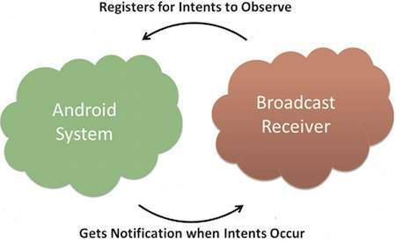
Broadcast receivers
Introduction

Slide 21
Broadcast Receivers
They are app components that enable the reception of system events
Like: Low Battery, power connected, system shutdown, alarm, picture captured, ...
The system can deliver broadcasts even to apps that aren't currently running
They do not provide an user interface but allow to create a status bar with notifications
They should perform short actions, sending long action to asynchronous Tasks (using goAsync() or a JobService/JobScheduler)
Apps can also initiate broadcasts
Enabling communication inside and between apps
https://developer.android.com/guide/components/broadcasts.html

Slide 22
Broadcast Receivers: Sending and Receiving
Sending broadcasts
Receiving broadcasts
Communication inside the app
Intent intent = new Intent();
Intent.setAction("dam.a60000.bookreceiver.action.BOOK_NEW");
Intent.addCategory(Intent.CATEGORY_DEFAULT);
Intent.setData(Uri.parse("http://www.dam.com/9781430248279"));
sendBroadcast(intent);
public class BookBroadcastReceiver extends BroadcastReceiver {
public void onReceive(Context context, Intent intent) {
. . .
}
}
LocalBroadcastManager().sendBroadcast(intent); // instead of sendBroadcast()

Slide 23
Broadcast Receivers: Registration
In AndroidManifest.xml file
Apps can register to receive specific broadcasts
In Manifest-declared receivers, or
In Context-registered receivers (Java Code)
<manifest xmlns:android="http://schemas.android.com/apk/res/android”
package="com.apress.bookprovider">
<application>
…
<receiver
android:name=".BookBroadcastReceiver"
android:enabled="true"
android:exported="true">
<intent-filter>
<action android:name="com.ami.bookreceiver.action.BOOK_NEW" />
<category android:name="android.intent.category.DEFAULT" />
</intent-filter>
</receiver>
…
</application>
</manifest>

Slide 24
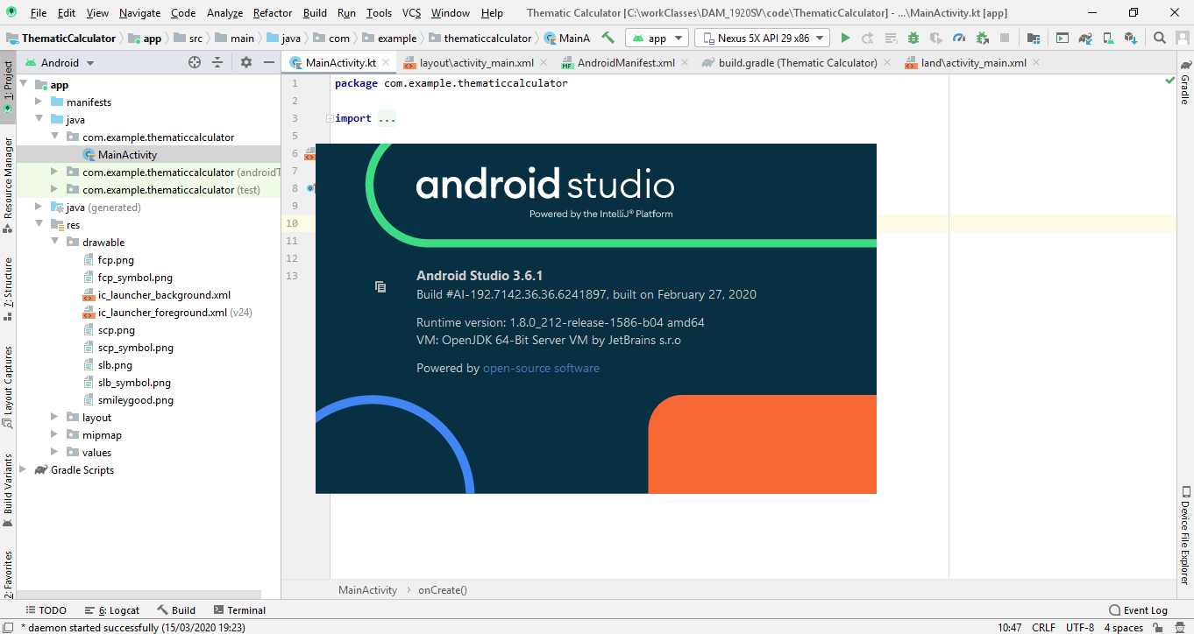
Android Studio

Slide 25



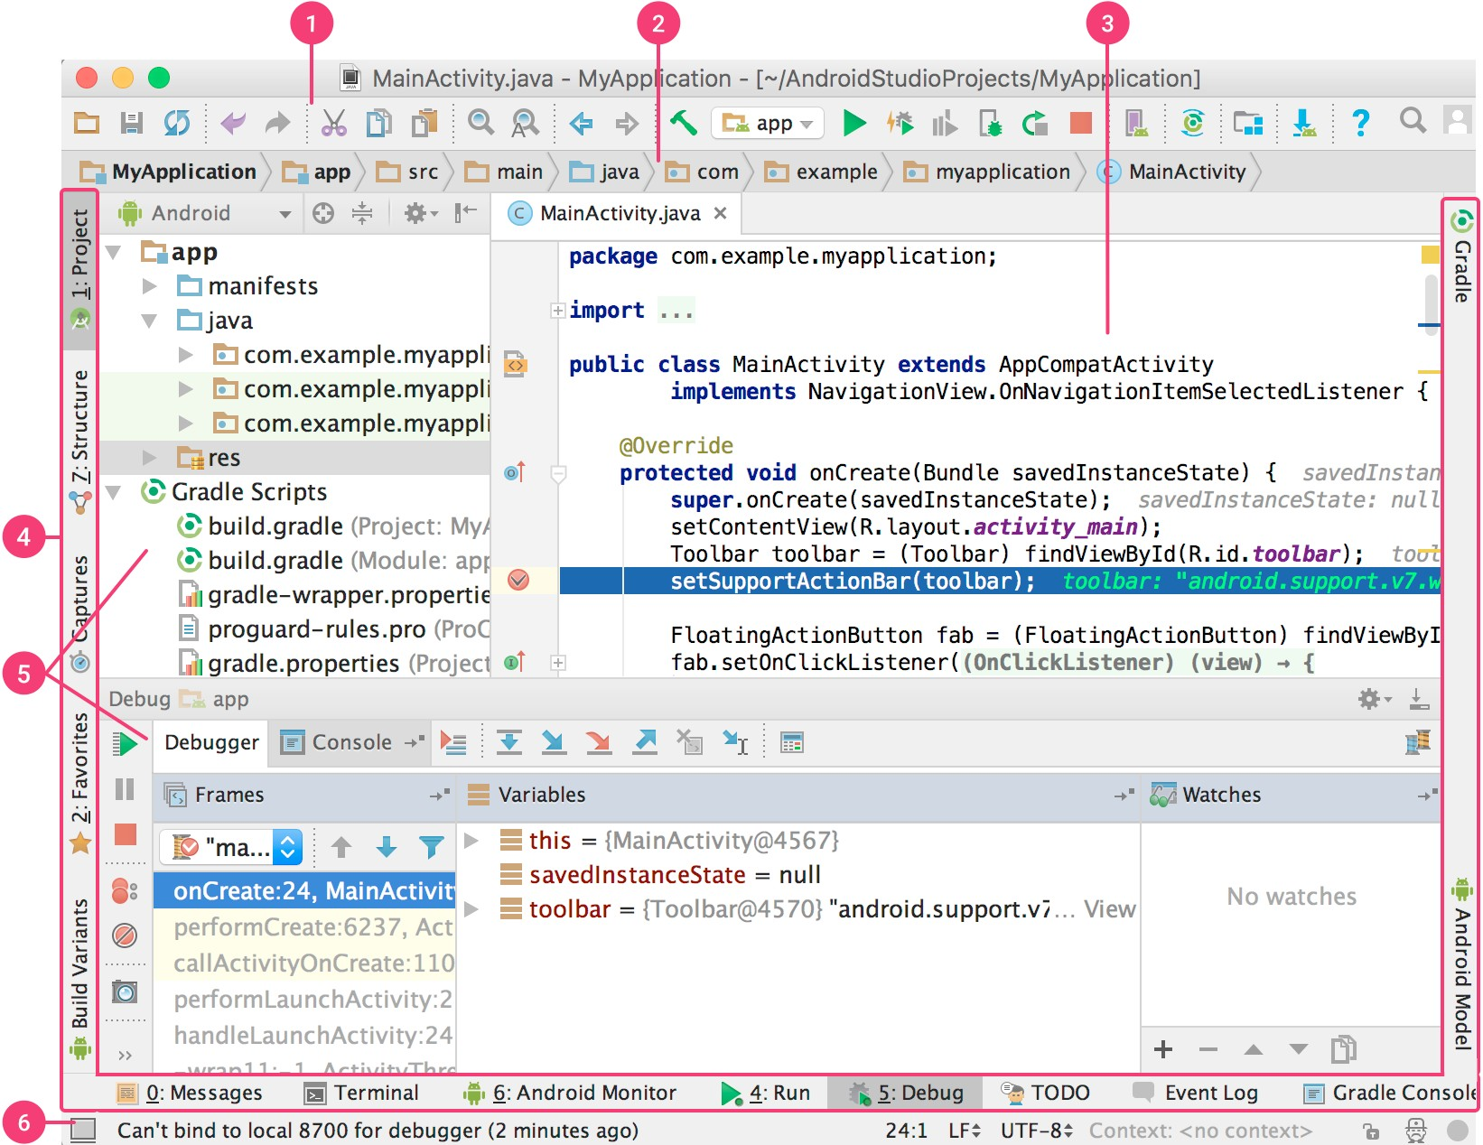



Android Studio
Toolbar
Navigator Bar
Editor Window
Project Tool window
8
Tool Window Bar
Tool Windows
Status Bar

Slide 26
Android Studio: Caption
Toolbar: carries out a wide range of actions, including running your apps and launching Android tools.
Navigation bar: navigation through your project and open files for editing.
Editor Window: to create and modify code. It is loaded the correct editor for each file. For example, for a layout file, the Layout Editor is used.
Tool Window bar: contains the buttons for minimized tool windows.
Tool Windows: access to specific tasks, like project management, search, version control, and more. Could be expanded and collapsed.
Status bar: displays the status of your project and the IDE itself, as well as any warnings or messages.
Project Tool Window: to view the project in one of several modes: Android, Project, Packages, … enabling to see the type of files that you want
LogCat: to view the all log messages send by the used device: app output, app log, app exceptions, …

Slide 27
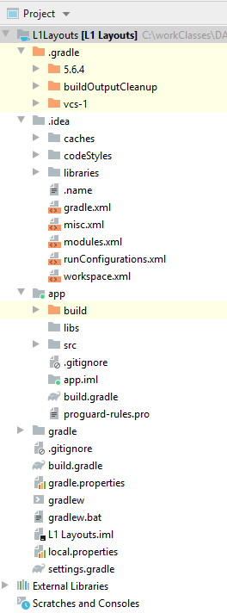
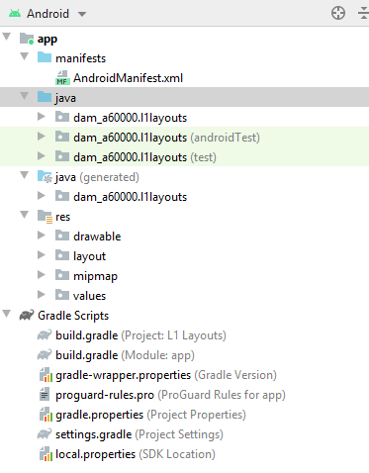
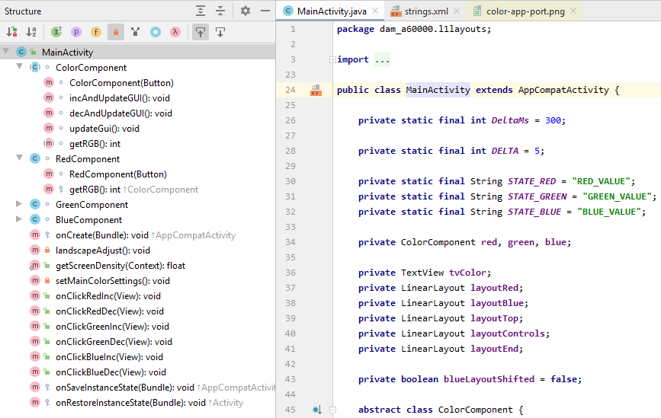
Project and Structure Tool Windows
Project tool window: show project files
Project view – show all Project files
Android View – Show project files for Android development
Structure tool window: show the structure of what is seen in editor
similar to Outline in Eclipse

Slide 28


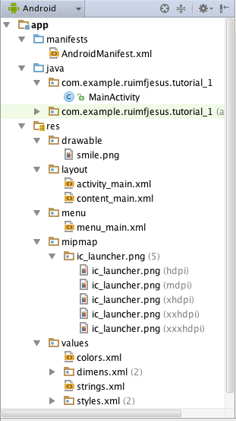
















Project Elements
Application configuration file
Java code of the Activity
All resources that are not code
Images used in the application at various resolutions
Activity Layout
Application Menu
Icons used in various resolutions
Constant data values (e.g., colors, strings, or styles)
Strings used in the application

Slide 29
Use of XML for definitions
Of application resources”
Layouts, Menus, Views (User Interface)
Values (e.g., strings.xml)
Of application properties
AndroidManifest.xml
User interface described in XML
Separate the layout description from the code that controls it
Easier to adapt User Interface to different platforms
Visual Editors automatically create XML (Android Studio)

Slide 30
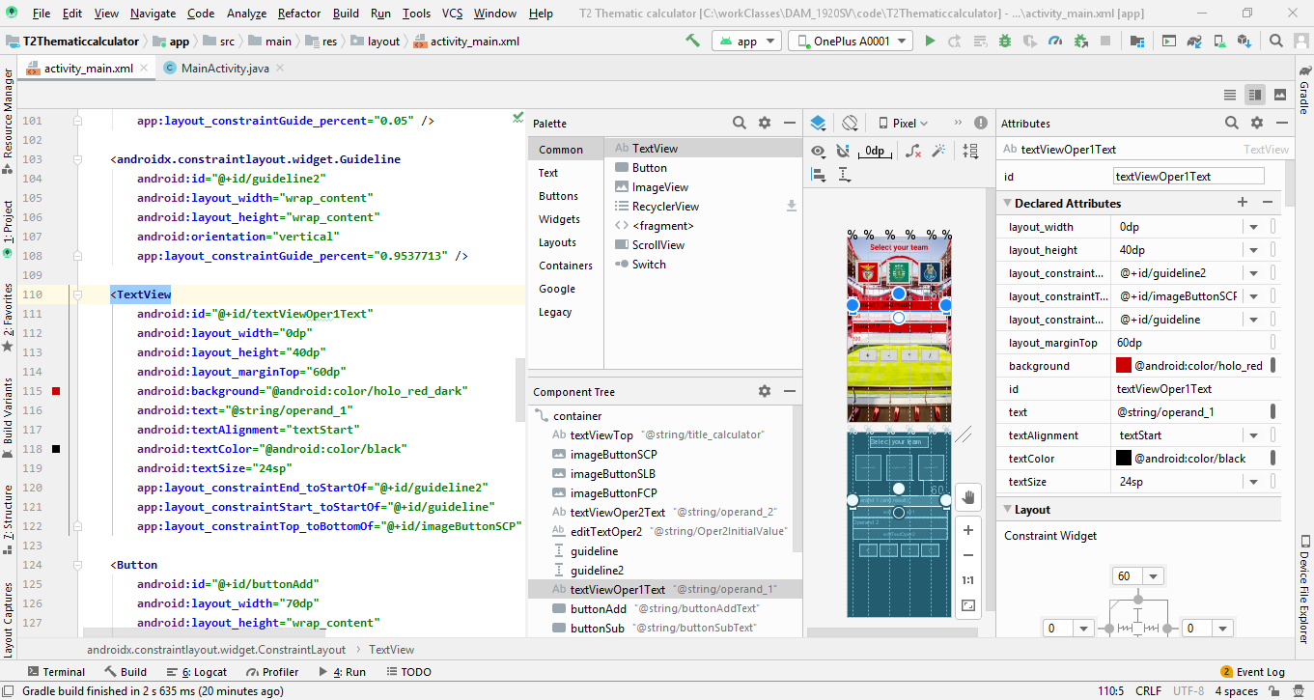
res/layout: User Interface of the Layouts Editor

Slide 31
Applications resources described in XML files
Strings should be defined in: res/values/strings.xml
Enables to change string content to other contexts (languages)
Example:
Other values in "values" follow the same principle
colors.xml, dimens.xml, styles.xml
Resources (string, integer, array, color, dimension, bool, ID) are inside files with <resources> as its root element
It doesn’t matter the file name – what is relevant is the resource declaration
<resources>
<string name="app_name">Tutorial_1</string>
<string name="action_settings">Settings</string>
<string name="msg1">Olá Mundo!</string>
<string name="msg2">Esta é a minha primeira aplicação Android!!</string>
<string name="image">smile</string>
</resources>

Slide 32
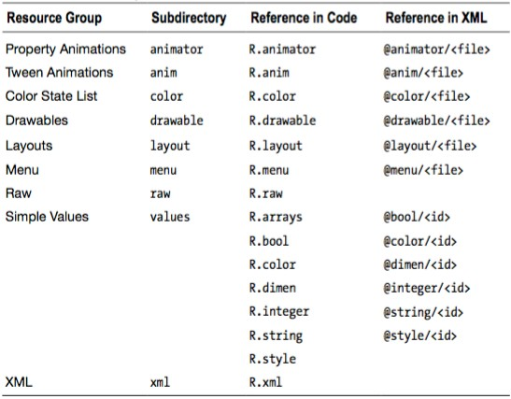
Resources: location and references

Slide 33
Resources in code
Get reference to a View based on resource id
findViewById()
Get resource contents
getResources()
And use getString, getInteger, …
// ID resource
<TextView android:id="@+id/textViewHello“
... />
// non-ID resources
<string name="hello">Hello</string>
<integer name="initValue">100</integer>
// get reference to a ID resource
TextView tvHello = findViewById(R.id.textViewHello);
// get a resource string
String str = getResources().getString(R.string.hello));
// get a resource Integer
int initvalue = getResources().getInteger(R.integer.initValue);

Slide 34
Array Resources - String and Integer arrays
Arrays of Strings and Integers
To define in XML: string-array, integer-array
In use in code: getStringArray, getIntegerArray
<?xml version="1.0" encoding="utf-8"?> <resources> <string-array name="planets_array"> <item>Mercury</item> <item>Venus</item> <item>Earth</item> <item>Mars</item> </string-array> </resources>
To create an array file: over res directory select new -> Android Resource File -> keep all (Resource type Values, directory name of values) and set File name: arrays
// get reference to a ID resource
Resources res = getResources(); String[] planets = res.getStringArray(R.array.planets_array);

Slide 35
Array Resources - untyped arrays
Arrays of untyped elements, called TypedArrays
Arrays may contain elements of any type in the same array
Elements may reference other resources, even drawables or arrays
In define in XML: array
In use in code: obtainTypedArray
<array name="cities"> <item>@array/lisboa</item> <item>@array/porto</item> </array> <array name="lisboa"> <item>Lisboa</item> <item>504718</item> </array> <array name="porto"> <item>Porto</item> <item>#214349</item> </array>
TypedArray arrayCities = res.obtainTypedArray(R.array.cities); for (int idx = 0; idx < arrayCities.length(); idx++) { int idCity = arrayCities.getResourceId(idx, -1); TypedArray city = res.obtainTypedArray(idCity); String name = city.getString(0); @SuppressLint("ResourceType") int population = city.getInt(1, 0); Log.d(LOG_MSG, "City: " + name + ", " + population); }

Slide 36
One simple app

Slide 37
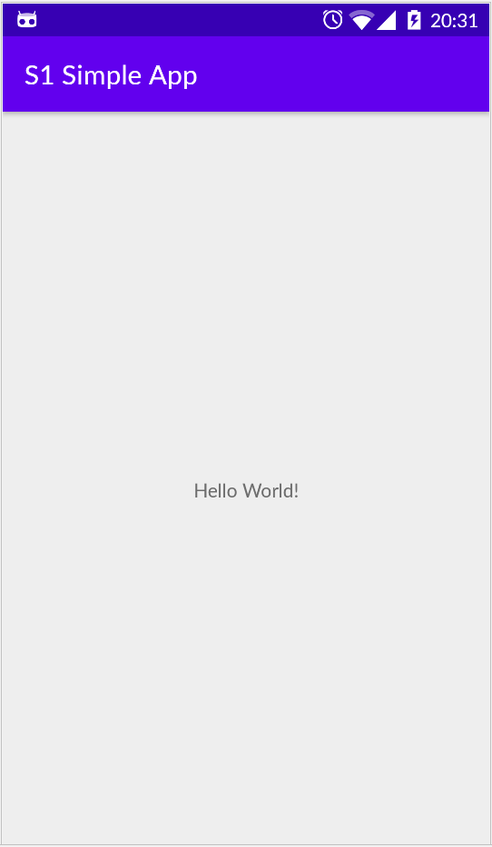
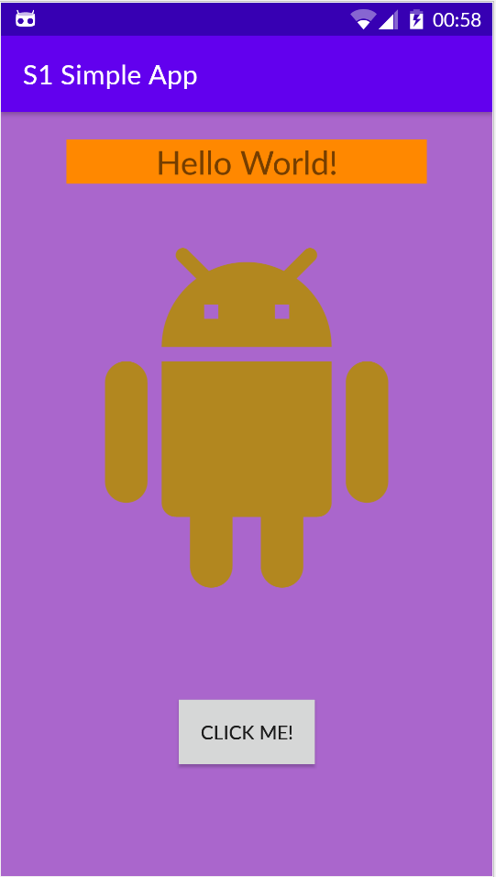
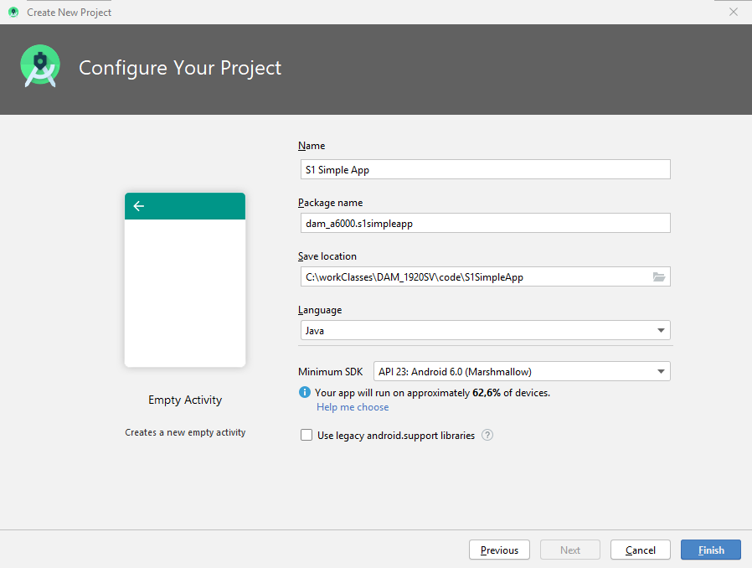
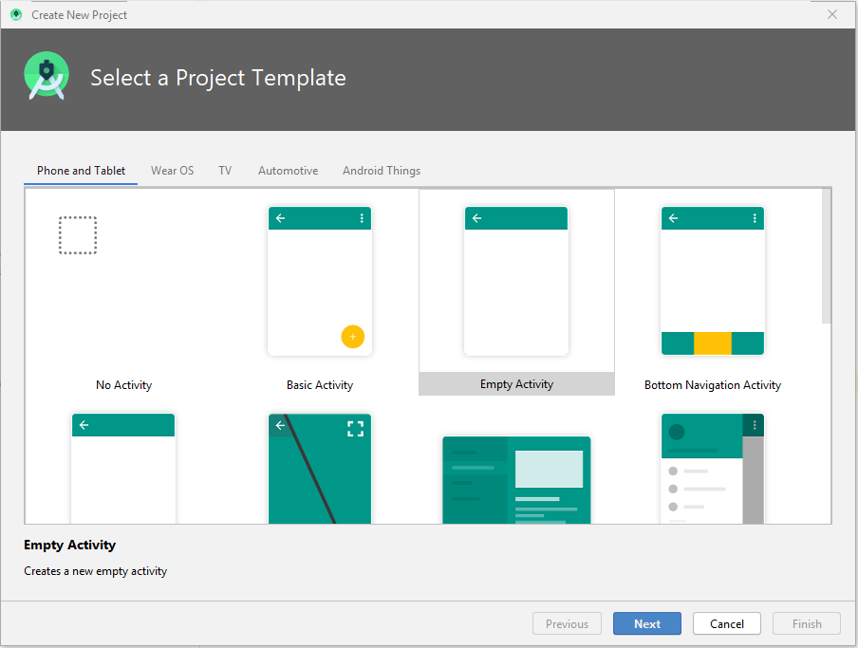
A simple app
Create a simple project with one activity
File -> New -> New project -> Empty Activity
Name: S1 Simple App, package name: dam_a60000, Finish
Run the app
Next: activity, layout, Strings, manifest, build.gradle

Slide 38

Simple App: layout contents
Added:
TextView: Background color, textSize
ImageView: with Android Image Asset
Button: with CLICK ME! Text (on Strings.xml)
Layout: Background color

Slide 39
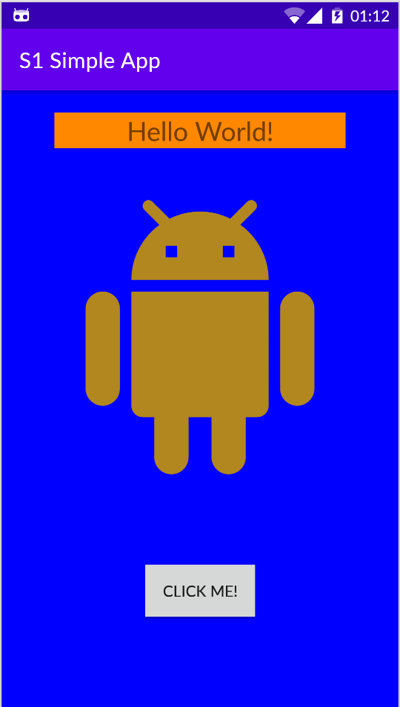
Simple app v2: MainActivity
Extends AppCompatActivity
public class MainActivity extends AppCompatActivity {
@Override
protected void onCreate(Bundle savedInstanceState) {
super.onCreate(savedInstanceState);
setContentView(R.layout.activity_main);
final ViewGroup vgMainLayout = findViewById(R.id.MainConstraintLayout); Button btnClickMe = findViewById(R.id.buttonClickMe); btnClickMe.setOnClickListener(new View.OnClickListener(){
int oldColor = Color.GREEN; @Override public void onClick(View v) { int color = ((ColorDrawable)vgMainLayout.getBackground()).getColor(); if (color == Color.BLUE) color = oldColor; else { oldColor = color; color = Color.BLUE; } vgMainLayout.setBackgroundColor(color); } }); } }
onCreate() called after activity is created. Should initialize it.
Sets activity layout
Sets onClickListener on button
Sets onclick event method to change the layout’ background

Slide 40
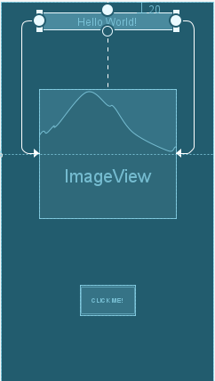
Layout: “activity_main.xml”
<androidx.constraintlayout.widget.ConstraintLayout
xmlns:android="http://schemas.android.com/apk/res/android" xmlns:app="http://schemas.android.com/apk/res-auto" xmlns:tools="http://schemas.android.com/tools" android:id="@+id/MainConstraintLayout" android:layout_width="match_parent"
android:layout_height="match_parent" android:background="@android:colo/holo_purple" tools:context=".MainActivity" tools:ignore="ContentDescription"> <TextView android:id="@+id/textViewMain" android:layout_width="0dp" android:layout_height="wrap_content" android:layout_marginTop="20dp" android:background="@android:color/holo_orange_dark" android:text="@string/hello_str" android:textAlignment="center" android:textSize="24sp" app:layout_constraintEnd_toEndOf="@+id/imageViewAndroid" app:layout_constraintStart_toStartOf="@+id/imageViewAndroid" app:layout_constraintTop_toTopOf="parent" />
. . .

Slide 41
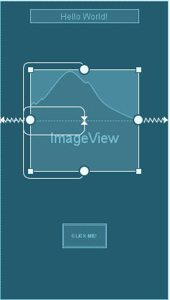
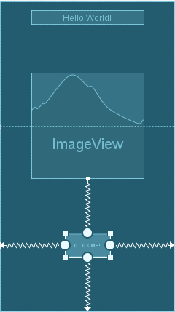
Layout: “activity_main.xml”
. . .
<androidx.constraintlayout.widget.Guideline android:id="@+id/guideline" android:layout_width="wrap_content" android:layout_height="wrap_content" android:orientation="horizontal" app:layout_constraintGuide_percent="0.4" /> <ImageView android:id="@+id/imageViewAndroid" android:layout_width="264dp" android:layout_height="249dp" app:layout_constraintBottom_toTopOf="@+id/guideline" app:layout_constraintEnd_toEndOf="parent" app:layout_constraintStart_toStartOf="parent" app:layout_constraintTop_toTopOf="@+id/guideline" app:srcCompat="@drawable/ic_android_black_24dp" /> <Button android:id="@+id/buttonClickMe" android:layout_width="wrap_content" android:layout_height="wrap_content" android:padding="20dp" android:text="@string/button_text" app:layout_constraintBottom_toBottomOf="parent" app:layout_constraintEnd_toEndOf="parent" app:layout_constraintStart_toStartOf="parent" app:layout_constraintTop_toBottomOf="@+id/imageViewAndroid" /> </androidx.constraintlayout.widget.ConstraintLayout>

Slide 42
Layout notes
Used ConstraintLayout
Used a HorizontalGuideline at 50% of vertical size
ImageView with top and bottom constraints connected to Guideline
Left and right contraints connected to parent
TextView at top
with top constraint to top of layout but with a margin_top
Left and right horizontal constraints to left and right size of ImageView
With layout_width = 0dp
Button
with some padding and constraints to parent and TextView
https://developer.android.com/training/constraint-layout

Slide 43
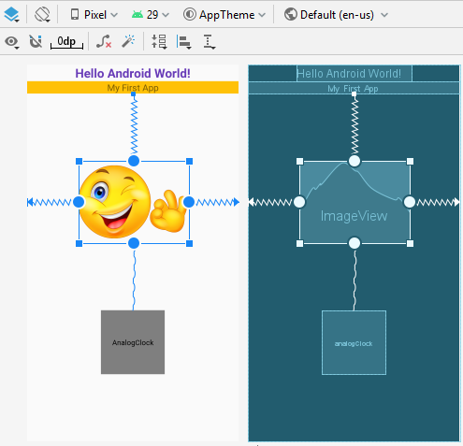
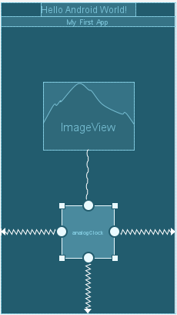
ConstraintLayout: distribute elements vertically / horizontally
Distribute elements vertically or horizontally
Use double constraints between elements (from one to the other and vice-versa).
To set them use Align menu icon and align both elements Vertically or horizontally:
vertically in figure (check the constraint visual aspect – is different from normal constraint)
Can be used to distribute any number of elements

Slide 44
res\values\String.xml
<resources> <string name="app_name">S1 Simple App</string> <string name="button_text">Click me!</string> <string name="hello_str">Hello World!</string> </resources>

Slide 45

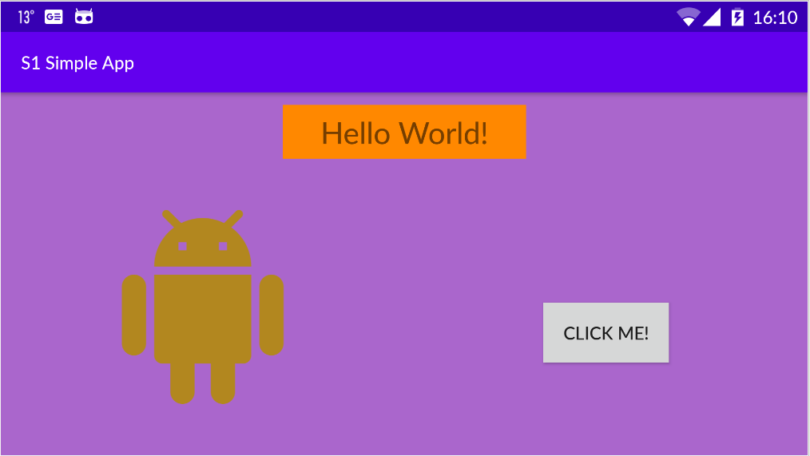
Lanscape variation layout
Create Lanscape variation
In Design editor, in Orientation for Preview icon
It is created one more layout with the same name, but with (land)
Orgnaize the existing/original componentes in the new landscape variant

Slide 46
AndroidManifest.xml
<?xml version="1.0" encoding="utf-8"?>
<manifest
xmlns:android="http://schemas.android.com/apk/res/android"
package="dam_a60000.s1simpleapp">
<application
android:allowBackup="true"
android:icon="@mipmap/ic_launcher"
android:label="@string/app_name"
android:roundIcon="@mipmap/ic_launcher_round"
android:supportsRtl="true"
android:theme="@style/AppTheme">
<activity
android:name=".MainActivity">
<intent-filter>
<action android:name="android.intent.action.MAIN" />
<category android:name="android.intent.category.LAUNCHER" />
</intent-filter>
</activity>
</application>
</manifest>
Package ID: unique name that identifies the package
Application features: icons, name, theme used in formatting, ...

Slide 47

Gradle build system
“Gradle is an open-source build automation tool focused on flexibility and performance.
Gradle build scripts are written using a Groovy or Kotlin DSL.” *
DSL – Domain Specific Language
* https://docs.gradle.org/current/userguide/userguide.html

Slide 48
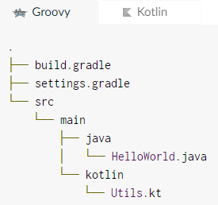
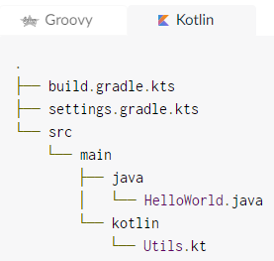
Gradle
Gradle’s language plugins establish conventions for discovering and compiling source code.
For example, a project applying the Java plugin will automatically compile the code in the directory src/main/java.
The last portion of the directory path usually indicates the expected language of the source files.
For Kotlin is src/main/kotlin

Slide 49
“build.gradle” file
apply plugin: 'com.android.application'
android {
compileSdkVersion 29
buildToolsVersion "29.0.2"
defaultConfig {
applicationId “dam_a60000.s1simpleapp"
minSdkVersion 23
targetSdkVersion 19
versionCode 1
versionName "1.0“
testInstrumentationRunner "androidx.test.runner.AndroidJUnitRunner"
}
buildTypes {
release {
minifyEnabled false
proguardFiles getDefaultProguardFile('proguard-android-optimize.txt’),
'proguard-rules.pro’
}
}
}
dependencies {
compile fileTree(dir: 'libs’, include:['*.jar’])
implementation 'androidx.appcompat:appcompat:1.1.0’ implementation 'androidx.constraintlayout:constraintlayout:1.1.3’ testImplementation 'junit:junit:4.12’ androidTestImplementation 'androidx.test.ext:junit:1.1.1’ androidTestImplementation 'androidx.test.espresso:espresso-core:3.2.0'
}
Configuration file for Gradle build system.

Slide 50
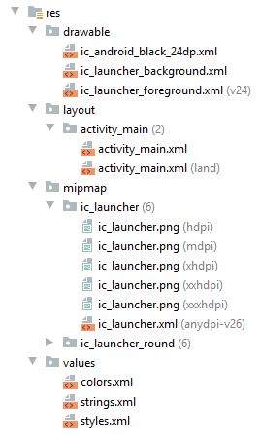
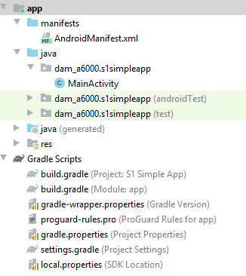
Android Studio all files

Slide 51
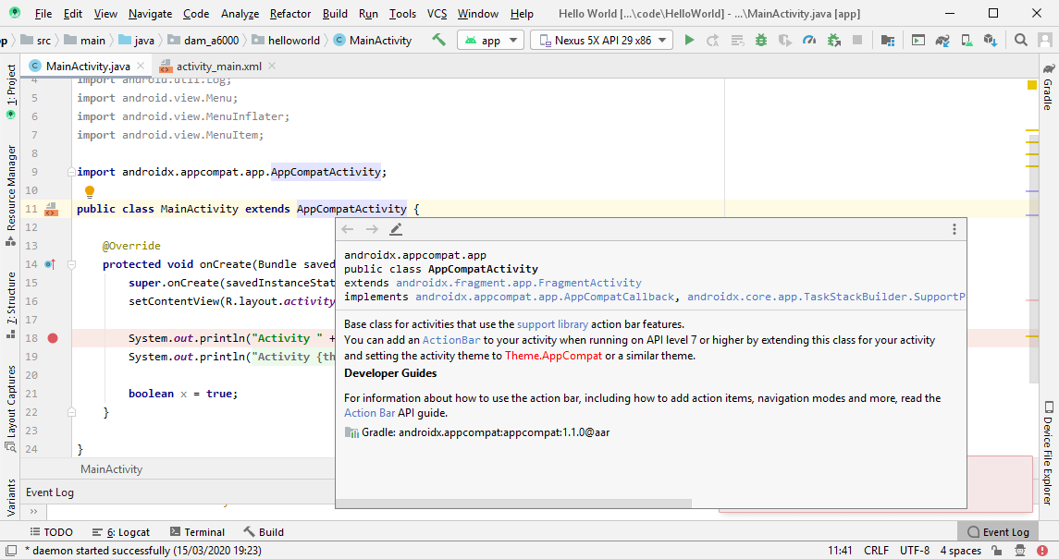
Android Studio: code documentation

Slide 52
Accessing code documentation
To open documentation in a manual pop-up window: select a “name” and:
Press: Ctrl+Q (on PC) or Ctrl+J (on Mac) or
Go: Menu -> View -> Quick Documentation
To open as a Tool Window: open the previous pop-up

Slide 53
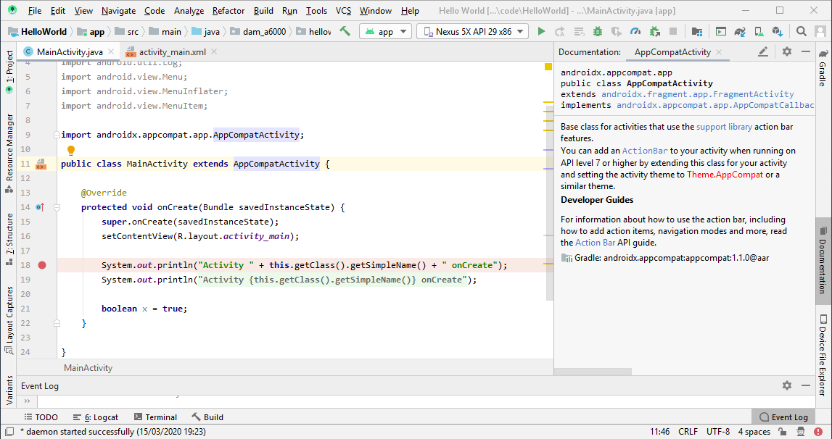
Accessing code documentation
To open documentation in a permanent Tool Window:
open the previous pop-up
In the top right vertical 3 dots choose: Open as Tool Window
You get a tool window that show the current documentation
You can minimize it or remove it by choosing Open as Popup in its settings

Slide 54
Accessing code documentation
To open documentation in an auto pop-up window:
The documentation window should be in pop-up mode
Go: File-> Settings-> Editor-> General: Other: Show quick documentation on mouse over
Increase the Delay, if the documentation is annoying you by appearing more often than what you want

Slide 55
Key mapping
Android Studio have its own key sequences for actions
These key sequences are diferente other editors
But we can change the key mapping as we want and even we can change the entire mapping for one of the existing configurations
Change the key mapping to Eclipse key mapping
If we want we can use the Eclipse key mapping – so we continue to use some Eclipse familiar key sequences like (but not all are adopted):
CTRL+Alt+O to organize imports
CTRL+ALT+L to format
To change the key mapping to Eclipse: File -> Settings -> keymap -> choose Keymap: Eclipse
We can always change the key sequence for any action
Go to: File -> Settings -> keymap and select the desired action and change its key sequence

Slide 56
Summary
Main Components - Activities, Services, Content Providers, Broadcast Receivers
Activities - a single screen with a user interface
Services - to perform long background operations
Content Providers – data access within and between applications
Broadcast Receivers - to receive and react to broadcast messages from other applications or the system
Elements of an Android project - AndroidManifest.xml file, Java code, resources (drawable, layout, menu, mipmap, values) and build.gradle
XML editor and visual user interface - Android studio contains visual and XML editors to create interface
MainActivity class - activity class extension
AndroidManifest file - configuration file with application features. Interface between the application and the system.
File build.gradle - configuration file that Gradle system uses to build the package. It can modify the Manifest file.
Code documentation – how to acces code documentation in Android Studio

Slide 57
Bibliography
Application Components
Resources
Layouts
ManifestAndroid
build.gradle

